Slide 1

Session 2.
Benefits of breastfeeding
© UNICEF/UNI114991/Holt

Slide 2
Session 2. Objectives
Benefits of breastfeeding
After completing this session, participants will be able to:
state the advantages of optimal infant feeding (exclusive and continued breastfeeding);
list the special properties of colostrum and why it is important;
describe the main differences between breast milk and artificial milk;
list the risks of artificial feeding.

Slide 3

Benefits of breastfeeding
Breast milk | Breastfeeding
Complete nutrients | Helps bonding and development
Easily digested | Helps delay a new pregnancy
Efficiently used | Protects mothers’ health
Protects against infection
Protects against long-term noncommunicable diseases
Costs less than artificial feeding
© UNICEF/UN0222431/Velazquez

Slide 4
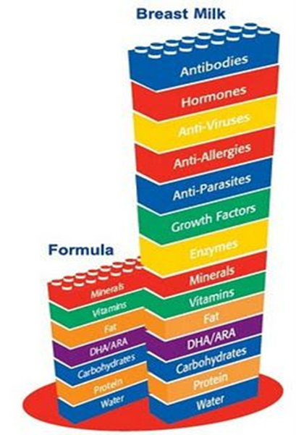
Nutrients in breastmilk and formula milks

Slide 5
Nutrients in human and animal milks
Human
Cow’s
Goat’s
Fat
Protein
Lactose
© Felicity Savage

Slide 6
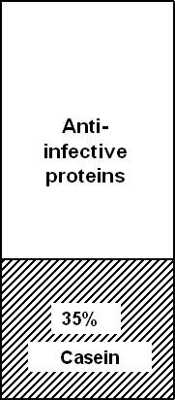

Quality of proteins in different milk
Human milk
Cow’s milk
Whey protein
Curds
Easy to digest
Difficult to digest
© Felicity Savage

Slide 7



Differences between colostrum and mature milk
Foremilk
Hindmilk
Fat
Protein
Lactose
Colostrum
Mature milk
© Felicity Savage

Slide 8
Colostrum
Property | Importance
Antibody rich | - Protects against allergy infection
Many white cells | - Protects against infection
Purgative | - Clears meconium -Helps to prevent jaundice
Growth factors | - Helps intestine to mature -Prevents allergy, intolerance
Rich in vitamin A | - Reduces severity of infection

Slide 9
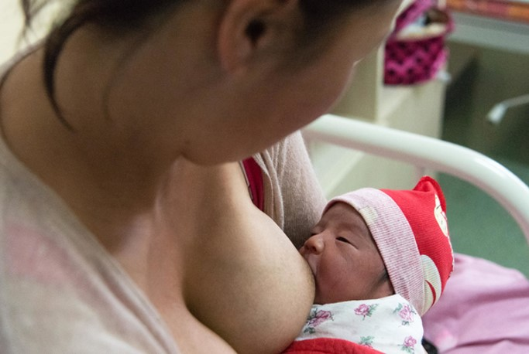
Protection against infection
Mother infected
White cells in mother’s body make antibodies to protect mother
Some white cells go to breast and make antibodies there
Antibodies to mother’s infection secreted in milk to protect baby
© UNICEF/UN0255446/Pasquall

Slide 10
Risk of diarrhoea by feeding method
Philippines, infants aged 0–2 months
Source: Popkin BM, Adair L, Akin JS, Black R, Briscoe J, Flieger W. Breast-feeding and diarrheal morbidity. Pediatrics. 1990;86:874–82.

Slide 11

Psychological benefits of breastfeeding
Emotional bonding
Close, loving relationship between mother and baby
Mother more emotionally satisfied
Baby cries less
Baby may be more emotionally secure
Development
Children perform better on intelligence tests
© Alamy, Mail on Line

Slide 12
Risks of not breastfeeding
May take more effort to bond with baby
More diarrhoea and persistent diarrhoea
More frequent respiratory infections
Malnutrition; vitamin A deficiency
More allergy and milk intolerance
Increased risk of some chronic diseases
Obesity
Lower scores on intelligence tests
Mother may become pregnant sooner
Increased risk of anaemia, ovarian cancer and breast cancer in mother

